Slide 1
The Bible in the Desert
The Desert Fathers and Mothers
Monasticism in the 4th-5th centuries

Slide 2
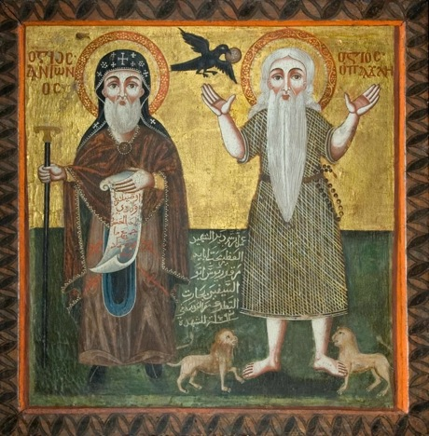
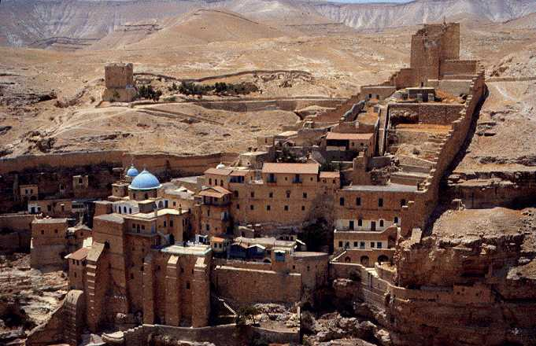
The Desert a City

Slide 3
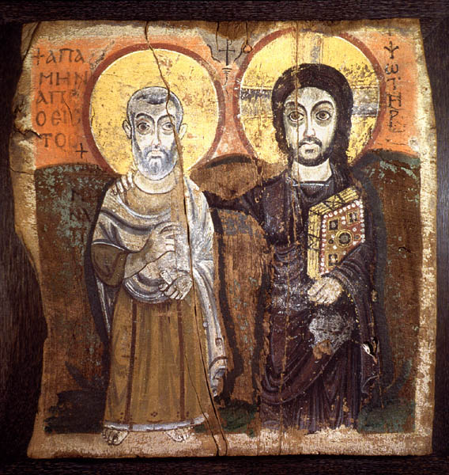
Desert Dwellers – Athletes of Christ
Monastic movement – 4th to 5th centuries
Social, economic, political causes have been advanced
Need for mediators with the divine (cf. Peter Brown)
Loss of fervor, commitment, and spirituality in Constantinian Church

Slide 4
Spirit of the Monks
Abba Lot went to see Abba Joseph and he said to him, "Abba, as far as I can, I say my little office, I fast a little, I pray and meditate, I live in peace and as far as I can I purify my thoughts. What else can I do?" Then the old man stood up and stretched his hands toward heaven; his fingers became like ten lamps of fire and he said to him, "If you will, you can become all flame.“
God is the life of all free beings. He is the salvation of all, of believers or unbelievers, of the just or the unjust, of the pious or the impious, of those freed from passions or those caught up in them, of monks or those living in the world, of the educated and the illiterate, of the healthy and the sick, of the young or the old. He is like the outpouring of light, the glimpse of the sun, or the changes of the weather which are the same for everyone without exception.
Abba Pambo said, "If you have a heart, you can be saved."

Slide 5
Monks and the Word of God
The monastic movement entailed a close engagement with Holy Scripture
Their hermeneutic: moral, spiritual, and mystical
The monks sought redemption and transformation
They believed they were living in the final days
What must I do to be saved?
Apophthegmata patrum (Sayings of the Fathers)

Slide 6
The Spoken Word
Oral culture
One was apprenticed to a spiritual master
The spoken word was ‘negotiated’
Great emphasis on body language, gesture, voice pitch and intonation, etc.
Almost obsession with language: slander a great evil for what it does both to the victim and the perpetrator
Speaking ill on another, idle words, silliness, etc. all were strongly discouraged

Slide 7
Serious and Practical
They were aware of the dangers of undisciplined and curious readings of Scripture
The sages or abbas were the ones who mediated scripture to their followers
Often in the form of a story – much of tradition is oral
Speculative question strongly discouraged – focus was to be on spiritual and ascetical matters
Disciples were taken up into Scripture – their ‘lives became conversations with scripture’
Pachomius – exegesis of tabernacle and Holy of Holies (Hebrews 9:1-5)

Slide 8
Holy of Holies
The brothers assembled at evening as was their custom. For in all seasons, when they had finished their modest meal, it was their habit to assemble and for each one to pronounce what he knew of the holy Scriptures…The brother who had returned from the north spoke and said, “allow me, my brothers, to tell you the saying and its commentary which I heard from a righteous man. It was while returning south that I passed by Tabennesi and was put up there at Abba Pachomius’s monastery. Toward evening Pachomius seated himself and spoke the Word of God to the brothers gathered around him. He spoke of the tabernacle and of the Holy of Holies, applying them to two peoples. The first people is the outer tabernacle, whose service consisted in sacrifices and visible loaves; the Holy of Holies, on the other hand, is the Gentiles’ calling which, according to the gospel, is the fulfillment of the law. And all the objects that are found in this inner tabernacle are filled with glory. For instead of animal sacrifices, there is the altar of incense; instead of the table, the ark containing the spiritual loaves, that is, the fullness of the law and all that is to be found there; and instead of the light of the lamp, the mercy seat where God appears as a consuming fire, that is, God the Word made human who became remission for us by appearing in the flesh. The words mercy seat mean indeed the place of the remission of sins. When the brother had finished his exposition of that saying and its commentary, he said, “I am confident that God will forgive me many of my sins because of the remembrance of that just man whose name I just pronounced here before you.” all the brothers uttered their admiration for the great knowledge that was in our father Pachomius, until it was time for each of them to return with joy to his cell. (Life of Pachomius) Hebrews 9:1-5.

Slide 9
Imitation More Than Flattery
Performative reading of Scripture
Mimesis – embodiment of their spirituality
The stellar examples of wisdom and virtue were the focus of their mimesis
In a sense, they were ‘living in’ the bible
Nilus of Ancyra (5th century) refers to 1 Cor 3:22: ‘world is ours’ – his statement: We are the world now

Slide 10
Living Scripture
Abba, give me a word!
Desert hermeneutic
Synaxis – master/disciple
Reciting and meditating in cells
Words of the holy ones are a continuation of the discourse of Sacred Scripture
Praxis
How to ‘obtain or appropriate’ a saying

Slide 11
Watch Your Mouth
‘asceticism of language’ – great care taken with words – correct words, in right proportion, etc.
Heart and mouth; words and life
Abba Poemen: ‘Teach your mouth to say that which you have in your heart…teach your heart to guard what your tongue teaches’.
‘A person may seem to be silent but if his heart is condemning others he is babbling ceaselessly. But there may be another who talks from morning till night and yet he is truly silent; that is, he says nothing that is not profitable’.
Abba Or never lied, swore, hurt anyone, or spoke without necessity.
Integrity between speech and what is inside a person.
Language <<<>>> pure heart – important part of desert hermeneutic

Slide 12
Asceticism of Language - Silence
Having withdrawn from the palace to the solitary life, Abba Arsenius prayed and heard a voice saying to him, "Arsenius, flee, be silent, pray always, for these are the source of sinlessness."
A brother in Scetis went to ask for a word from Abba Moses and the old man said to him, "Go and sit in your cell and your cell will teach you everything."
Abba Nilus said, "The arrows of the enemy cannot touch one who loves quietness; but he who moves about in a crowd will often be wounded."
Theophilus of holy memory, bishop of Alexandria, journeyed to Scetis and the brethren coming together said to Abba Pambo, "Say a word or two to the bishop, that his soul may be edified in this place." The old man replied, "If he is not edified by my silence, there is no hope that he will be edified by my words."
This place was called Cellia, because of the number of cells there, scattered about the desert. Those who have already begun their training there [i.e. in Nitria] and want to live a more remote life, stripped of external things, withdraw there. For this is the utter desert and the cells are divided from one another by so great a distance that no one can see his neighbour nor can any voice be heard. They live alone in their cells and there is a huge silence and a great quiet there. Only on Saturday and Sunday do they meet in church, and then they see each other face to face, as men restored to heaven.

Slide 13
Renunciation and Detachment
Matt 19:21 (If you want to be perfect, sell all you have and give to the poor, and you will have treasure in heaven)
Matt 7:13-14 (the narrow gate)
Matt 6:34 (Do not worry about tomorrow)
Matt 6:33 (Seek first God’s Kingdom)
Psalm 55:22 (Cast your burden on the Lord and He will sustain you)

Slide 14
Against Pride – for Humility
1 Cor 10:12 (No false pride at accomplishments)
Psalm 25:18 (Be always aware of one’s own sin)
Matt 5:11 (when people revile and persecute you)
1 Cor 4:13 (We have become like the rubbish of the world, the dregs of all things)
Luke 18:32 (despised by others)
2 Cor 6:8 (bear dishonor)
The prize: Philippians 2:6-11 the kenotic hymn

Slide 15
Compassion – ‘The Commandment’
Refraining from anger or judging another
Eph 4:26 (Don’t let the sun go down on your anger)
Evagrius: anger the ‘fiercest passion’
1 Cor 13:1-3 (‘A man who is angry, even if he were to raise the dead, is not acceptable to God’ (Abba Agathon)
Matt 5:22 (If your brother hurts you by his arrogance and you are angry with him because of it, that is getting angry without cause (Abba Poemen)
Matt 5:29-30 (If your brother plucks out your right eye and cuts off your right hand and you get angry with him because of it, that is getting angry without cause)
Matt 7:5 (First take the log out of your own eye….)
Judging others considered worse than fornication

Slide 16
Judging Others
The old men used to say, "there is nothing worse than passing judgement."
They said of abba Macarius that he became as it is written a god upon earth, because just as God protects the world, so abba Macarius would cover the faults that he saw as though he did not see them, and those which he heard as though he did not hear them.
Abba Pastor said, "Judge not him who is guilty of fornication, if you are chaste, or you will break the law like him. For He who said "do not commit fornication" said also "Do not judge"."
A brother asked abba Poemen, "If I see my brother sin, is it right to say nothing about it?" The old man replied, "whenever we cover our brother's sin, God will cover ours; whenever we tell people about our brother's guilt, God will do the same about ours."
A brother in Scetis committed a fault. A council was called to which abba Moses was invited, but he refused to go to it. Then the priest sent someone to him, saying, "Come, for everyone is waiting for you". So he got up and went. He took a leaking jug and filled it with water and carried it with him. The others came out to meet him and said, " what is this, father?" The old man said to them, "My sins run out behind me, and I do not see them, and today I am coming to judge the errors of another." When they heard that, they said no more to the brother but forgave him.
A brother sinned and the priest ordered him to go out of the church; abba Bessarion got up and went out with him, saying, "I, too, am a sinner."

Slide 17
Love
Abba Poemen said, "There is no greater love than that a man lays down his life for his neighbour. When you hear someone complaining and you struggle with yourself and do not answer him back with complaints; when you are hurt and bear it patiently, not looking for revenge; then you are laying down your life for your neighbour."
One of the beloved of Christ who had the gift of mercy used to say, "The one who is filled with mercy ought to offer it in the same manner in which he has received it, for such is the mercy of God."
Abba Antony said, "I no longer fear God, I love him; for love casts out fear."

Slide 18
Self-Control and Peace
One of the brothers asked Abba Isidore, a priest of Scetis, "Why are the demons so terrified of you?" And the old man said, "Ever since I became a monk I have tried never to let anger rise as far as my mouth."
Abba Joseph asked Abba Nisteros, "What should I do about my tongue, for I cannot control it?" The old man said to him, "When you speak, do you find peace?" He replied, "No." The old man said to him, "If you do not find peace, why do you speak? Be silent, and when a conversation takes place, prefer to listen rather to talk."
Two old men had lived together for many years and they had never fought with one another. The first said to the other, "Let us also have a fight like other men." The other replied, "I do not know how to fight." The first said to him, "Look, I will put a brick between us and I will say: it is mine; and you will reply: no, it is mine; and so the fight will begin." So they put a brick between them and the first said, "No, it is mine", and the other said, "No, it is mine." And the first replied, "If it is yours, take it and go." So they gave it up without being able to find a cause for an argument.

Slide 19
Biblical Virtuosity
Once three brothers came to visit an old man in Scetis and one of them said to him, "Abba, I have committed to memory the Old and New Testaments." And the old man answered, "You have filled the air with words." The second one said to him, "I have written out the Old and New Testaments with my own hands." He said, "And you have filled the window-ledge with manuscripts." Then the third said, "The grass is growing up my chimney." And the old man replied, "You have driven away hospitality."

Slide 20
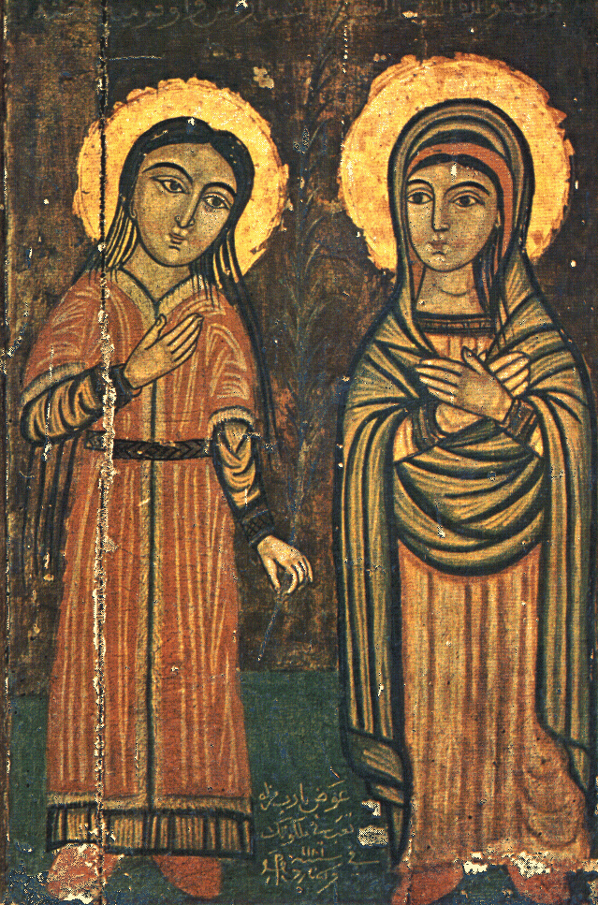
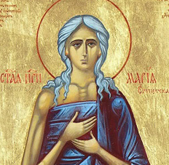
Desert Mothers

Slide 21
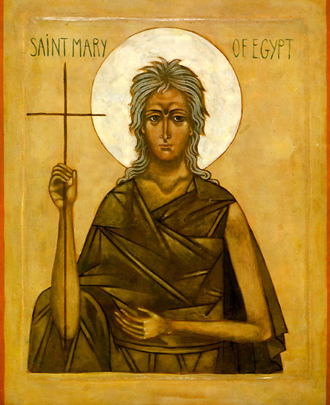
St. Mary of Egypt
Mary of Egypt c. 344 – c. 421
Dissolute life
Converted in Jerusalem – baptized in Jordan
Years of penitence and prayer
Great miracles – walking on water

Slide 22
Sayings of Mothers
Amma Theodora said, “Let us strive to enter by the narrow gate. Just as the trees, if they have not stood before the winter’s storms cannot bear fruit, so it is with us; this present age is a storm and it is only through many trials and temptations that we can obtain an inheritance in the kingdom of heaven.”
She also said that neither asceticism, nor vigils nor any kind of suffering are able to save, only true humility can do that. There was an anchorite who was able to banish the demons; and he asked them, “What makes you go away? Is it fasting?” They replied, “We do not eat or drink.” “Is it vigils?” They replied, “We do not sleep.” “Is it separation from the world?” “We live in the deserts.” “What power sends you away then?” They said, “Nothing can overcome us, but only humility.” Do you see how humility is victorious over the demons?
Amma Syncletica said, “Imitate the publican, and you will not be condemned with the Pharisee. Choose the meekness of Moses and you will find your heart which is a rock changed into a spring of water.”
She also said, “It is good not to get angry, but if this should happen, the Apostle does not allow you a whole day for this passion, for he says: Let not the sun go down. (Eph. 4.25) Will you wait till all your time is ended? Why hate the man who has grieved you? It is not he who has done the wrong, but the devil. Hate sickness but not the sick person.”
She also said, “Just as one cannot build a ship unless one has some nails, so it is impossible to be saved without humility.”

Slide 23
Two Controversies
Origenists versus Anthropomorphists – 4th-6th centuries
Those who eschewed images of God and moved to ‘higher’ realities and those who used human images of God for prayer and meditation
In the past, portrayed as a battle between intellectually superior and speculative Origenists one the one hand and illiterate, unsophisticated Coptic monks on the other
Much more complex: anti-pagan issues; monastic and ascetic discipline; biblical interpretation; theological anthropology; how God is to be prayed to and experienced

Slide 24
Not Look-Alikes
Anthropomorphism in relation to God – danger of Coptic monks slipping into traditional Egyptian notions of divinity
Theophilus of Alexandria in a Festal Letter of 399 insisted on the incorporeality of God
They focused on Genesis 1:26: created in the image (eikon) of God
Coptic monks such as Aphnou defended the use of human images of God for prayer – man is created in the image of the second person of the Trinity (not really compatible with formula of Nicea)

Slide 25
Devil is in the Images
Evagrius of Ponticus (345-399 AD) was an Origenist
Had teachings for the simple (praktike) and more advanced (gnostike)
mental images and thoughts are the enemy
One is subject to demonic attack
Memory and imagination are inferior mental faculties and are not capable of remaining focused on God
This is a perennial debate in all mystical and spiritual circles: images or no images; thoughts or no thoughts, etc.
Condemned along with Origen in 553 (Council of Constantinople)

Slide 26
Messalianism
Messalianism a loose ‘movement’ or tendency 4th-8th centuries throughout Asia Minor and East
Many condemnations – but there were moderate Messalians and radicals
Means ‘those who pray’ (Syriac)
Movement described as dualist and charismatic
Accused of devoting themselves exclusively to prayer to the almost total neglect of good works

Slide 27
Only a Man
It was said of Abba John the Dwarf that one day he said to his elder brother, "I should like to be free of all care, like the angels who do not work, but ceaselessly offer worship to God." So he took leave of his brother and went away into the desert. After a week he came back to his brother. When he knocked on the door he heard his brother say, "Who are you?" before he opened it. He said, "I am John, your brother." But he replied, "John has become an angel and henceforth he is no longer among men." Then John besought him, saying, "It is I." However, his brother did not let him in but left him there in distress until morning. Then, opening the door, he said to him, "You are a man and you must once again work in order to eat." Then John made a prostration before him, saying, "Forgive me."

Slide 28
Man: Home to Demons
As a result of Adam’s fall, all humans inhabited by a demon
Baptism or other sacraments useless against it
Prayer alone efficacious in expelling demon
One then experiences certitude
State of ‘apatheia’ – no ascetical practices necessary

Slide 29
Key Texts
Anti-Messalian polemical works almost only source of their doctrines and exegesis
John 6:27 – work not for perishable food but for eternity
Luke 10:38-49 – Martha and Mary – with the latter as their role model
1 Thess 5:17 – pray without ceasing
Real danger: either overly literal or overly figurative interpretations
Anti-Messalians tended to be moderate, practical, and to hold the two extremes in tension
Note story of Abba XXXX

Slide 30
Sin and Grace
Romans 5-7, especially 7:14-25
Body of sin, body of death
Pseudo-Macarius (moderate Messalian): still has choice, still has image of God; not under any compulsion
The psychological and spiritual struggles of monks was intimately connected with this passage and similar ones – especially the fact that struggles continue long after baptism

Slide 31
Inner Warfare
¹⁴ For we know that the law is spiritual; but I am of the flesh, sold into slavery under sin.
¹⁵ I do not understand my own actions. For I do not do what I want, but I do the very thing I hate.
¹⁶ Now if I do what I do not want, I agree that the law is good.
¹⁷ But in fact it is no longer I that do it, but sin that dwells within me.
¹⁸ For I know that nothing good dwells within me, that is, in my flesh. I can will what is right, but I cannot do it.
¹⁹ For I do not do the good I want, but the evil I do not want is what I do.
²⁰ Now if I do what I do not want, it is no longer I that do it, but sin that dwells within me.
²¹ So I find it to be a law that when I want to do what is good, evil lies close at hand.
²² For I delight in the law of God in my inmost self,
²³ but I see in my members another law at war with the law of my mind, making me captive to the law of sin that dwells in my members.
²⁴ Wretched man that I am! Who will rescue me from this body of death?
²⁵ Thanks be to God through Jesus Christ our Lord! So then, with my mind I am a slave to the law of God, but with my flesh I am a slave to the law of sin.
(Rom 7:14-25 NRS)

Slide 32
Spiritual Experience
Key text was Ephesians 4:13: until all of us come to the unity of the faith and of the knowledge of the Son of God, to maturity, to the measure of the full stature of Christ. (Eph 4:13 NRS)
All at once or progressive?
Messalians: stress spirit as fire (Matt 3:11; Heb 12:29)
Impassibility: Heb 12:22; Gal 4:26, utilizing symbol of heavenly Jerusalem
Mark the Hermit and others: experience of the spirit only a manifestation of baptismal grace at work
Macarius: struggles continue; no reason to be complacent as long as we are in the flesh
Macarius, Mark the Hermit, Diadochus of Photike point to 1 Thess 5:19 (Do not quench the spirit) and Eph 4:30 (Do not grieve the spirit) as indications that the spirit co-exists with sin and that the degree a person experiences it depends on the degree to which they have applied themselves to the spiritual and ascetical life

