Slide 1
St. Jerome
The Irascible Saint and Scholar

Slide 2
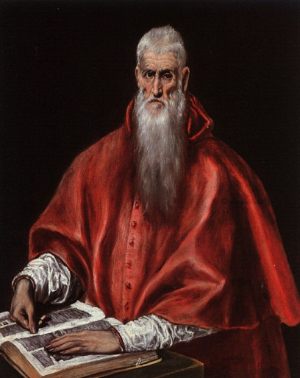
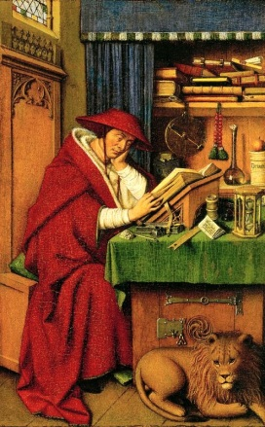
Jerome

Slide 3
347-420 AD
Well-trained in classics and master of the language
Accusation in a dream of not being a Christian but a Ciceronian
Wrote polemical works, homilies, letters, and commentaries
In his commentaries – prone to giving double translations in some of them; quoting from pagan classics; quoting from many other commentators in order that one may judge for oneself
Early in life a follower of Origen (my Master) but latter in life he moved away from him and repudiated his teachings (although still using some in his works)
Antiochene in his insistence on the historical, literal meaning of text
Alexandrian (especially Origen) in his moving beyond literal meaning to a deeper and fuller meaning – but literal had to be well explained first

Slide 4
His Master
Derived three influential things from Origen:
  Bible study as ascetic and spiritual practice
  Philological method focused on the text utilizing all the best in Greco-Roman literary studies
  Ethical hermeneutic – spiritual interpretations
Many treatises on ascetical life, virginity, etc. based on his exegesis

Slide 5
Birth of the Vulgate
Pope Damasus in 383 commissioned him to do a retranslation of the Old Latin texts
Enormous number of OL manuscripts with many, many, variant readings
Errors of translation and copying; a diversity of geographical areas
In short, linguistic and textual chaos
No one except Origen had known Hebrew
Jerome learned from a Jewish convert – found it very difficult and complained that it hampered his Latin style

Slide 6
Learning Hebrew
12. In my youth when the desert walled me in with its solitude I was still unable to endure the promptings of sin and the natural heat of my blood; and, although I tried by frequent fasts to break the force of both, my mind still surged with [evil] thoughts. To subdue its turbulence I betook myself to a brother11 who before his conversion had been a Jew and asked him to teach me Hebrew. Thus, after having familiarised myself with the pointedness of Quintilian, the fluency of Cicero, the seriousness of Fronto and the gentleness of Pliny, I began to learn my letters anew and to study to pronounce words both harsh and guttural. What labour I spent upon this task, what difficulties I went through, how often I despaired, how often I gave over and then in my eagerness to learn commenced again, can be attested both by myself the subject of this misery and by those who then lived with me. But I thank the Lord that from this seed of learning sown in bitterness I now cull sweet fruits. (Ep. 25.12)

Slide 7
Everyone is an Expert
7. The art of interpreting the scriptures is the only one of which all men everywhere claim to be masters. To quote Horace again
Taught or untaught we all write poetry.²
The chatty old woman, the doting old man, and the wordy sophist, one and all take in hand the Scriptures, rend them in pieces and teach them before they have learned them. Some with brows knit and bombastic words, balanced one against the other philosophize concerning the sacred writings among weak women. Others—I blush to say it—learn of women what they are to teach men; and as if even this were not enough, they boldly explain to others what they themselves by no means understand. I say nothing of persons who, like myself have been familiar with secular literature before they have come to the study of the holy scriptures. Such men when they charm the popular ear by the finish of their style suppose every word they say to be a law of God. They do not deign to notice what Prophets and apostles have intended but they adapt conflicting passages to suit their own meaning, as if it were a grand way of teaching—and not rather the faultiest of all—to misrepresent a writer’s views and to force the scriptures reluctantly to do their will. They forget that we have read centos from Homer and Virgil; but we never think of calling the Christless Maro ª Christian because of his lines:—
Now comes the Virgin back and Saturn’s reign,
Now from high heaven comes a Child newborn.⁴
Another line might be addressed by the Father to the Son:—
Hail, only Son, my Might and Majesty.⁵
And yet another might follow the Saviour’s words on the cross:—
Such words he spake and there transfixed remained.⁶
But all this is puerile, and resembles the sleight-of-hand of a mountebank. It is idle to try to teach what you do not know, and—if I may speak with some warmth—is worse still to be ignorant of your ignorance.

Slide 8
Joshua/Jesus
19 I will pass on to Jesus the son of Nave20—a type of the Lord in name as well as in deed—who crossed over Jordan, subdued hostile kingdoms, divided the land among the conquering people and who, in every city, village, mountain, river, hill-torrent, and boundary which he dealt with, marked out the spiritual realms of the heavenly Jerusalem, that is, of the church.1 In the book of Judges every one of the popular leaders is a type. Ruth the Moabitess fulfils the prophecy of Isaiah:—“Send thou a lamb, O Lord, as ruler of the land from the rock of the wilderness to the mount of the daughter of Zion.”2 Under the figures of Eli’s death and the slaying of Saul Samuel shews the abolition of the old law. Again in Zadok and in David he bears witness to the mysteries of the new priesthood and of the new royalty. The third and fourth books of Kings called in Hebrew Malâchim give the history of the kingdom of Judah from Solomon to Jeconiah,3 and of that of Israel from Jeroboam the son of Nebat to Hoshea who was carried away into Assyria. If you merely regard the narrative, the words are simple enough, but if you look beneath the surface at the hidden meaning of it, you find a description of the small numbers of the church and of the wars which the heretics wage against it. The twelve prophets whose writings are compressed within the narrow limits of a single volume,4 have typical meanings far different from their literal ones. Hosea speaks many times of Ephraim, of Samaria, of Joseph, of Jezreel, of a wife of whoredoms and of children of whoredoms,5 of an adulteress shut up within the chamber of her husband, sitting for a long time in widowhood and in the garb of mourning, awaiting the time when her husband will return to her.

Slide 9
More Prophecies
2 Zechariah, he that is mindful of his Lord,3 gives us many prophecies. He sees Jesus,4 “clothed with filthy garments,”5 a stone with seven eyes,6 a candle-stick all of gold with lamps as many as the eyes, and two olivetrees on the right side of the bowl7 and on the left. After he has described the horses, red, black, white, and grisled,8 and the cutting off of the chariot from Ephraim and of the horse from Jerusalem9 he goes on to prophesy and predict a king who shall be a poor man and who shall sit “upon a colt the foal of an ass.”10 Malachi, the last of all the prophets, speaks openly of the rejection of Israel and the calling of the nations. “I have no pleasure in you, saith the Lord of hosts, neither will I accept an offering at your hand. For from the rising of the sun even unto the going down of the same, my name is great among the Gentiles: and in every place incense11 is offered unto my name, and a pure offering.”12 As for Isaiah, Jeremiah, Ezekiel, and Daniel, who can fully understand or adequately explain them? The first of them seems to compose not a prophecy but a gospel. The second speaks of a rod of an almond tree13 and of a seething pot with its face toward the north,14 and of a leopard which has changed its spots.15 He also goes four times through the alphabet in different metres.16 The beginning and ending of Ezekiel, the third of the four, are involved in so great obscurity that like the commencement of Genesis they are not studied by the Hebrews until they are thirty years old. Daniel, the fourth and last of the four prophets, having knowledge of the times and being interested in the whole world, in clear language proclaims the stone cut out of the mountain without hands that overthrows all kingdoms.

Slide 10
More than meets the eye
17 David, who is our Simonides, Pindar, and Alcæus, our Horace, our Catullus, and our Serenus all in one, sings of Christ to his lyre; and on a psaltery with ten strings calls him from the lower world to rise again. Solomon, a lover of peace18 and of the Lord, corrects morals, teaches nature, unites Christ and the church, and sings a sweet marriage song19 to celebrate that holy bridal. Esther, a type of the church, frees her people from danger and, after having slain Haman whose name means iniquity, hands down to posterity a memorable day and a great feast.20 The book of things omitted21 or epitome of the old dispensation22 is of such importance and value that without it any one who should claim to himself a knowledge of the scriptures would make himself a laughing stock in his own eyes. Every name used in it, nay even the conjunction of the words, serves to throw light on narratives passed over in the books of Kings and upon questions suggested by the gospel. Ezra and Nehemiah, that is the Lord’s helper and His consoler, are united in a single book. They restore the Temple and build up the walls of the city. In their pages we see the throng of the Israelites returning to their native land, we read of priests and Levites, of Israel proper and of proselytes; and we are even told the several families to which the task of building the walls and towers was assigned. These references convey one meaning upon the surface, but another below it.

Slide 11
THE FOUR GOSPELS
Addressed to Pope Damasus, A.D. 383.
You urge me to revise the old Latin version, and, as it were, to sit in judgment on the copies of the Scriptures which are now scattered throughout the whole world; and, inasmuch as they differ from one another, you would have me decide which of them agree with the Greek original. The labour is one of love, but at the same time both perilous and presumptuous; for in judging others I must be content to be judged by all; and how can I dare to change the language of the world in its hoary old age, and carry it back to the early days of its infancy? Is there a man, learned or unlearned, who will not, when he takes the volume into his hands, and perceives that what he reads does not suit his settled tastes, break out immediately into violent language, and call me a forger and a profane person for having the audacity to add anything to the ancient books, or to make any changes or corrections therein? Now there are two consoling reflections which enable me to bear the odium—in the first place, the command is given by you who are the supreme bishop; and secondly, even on the showing of those who revile us, readings at variance with the early copies cannot be right. For if we are to pin our faith to the Latin texts, it is for our opponents to tell us which; for there are almost as many forms of texts as there are copies. If, on the other hand, we are to glean the truth from a comparison of many, why not go back to the original Greek and correct the mistakes introduced by inaccurate translators, and the blundering alterations of confident but ignorant critics, and, further, all that has been inserted or changed by copyists more asleep than awake? I am not discussing the Old Testament, which was turned into Greek by the Seventy elders, and¹ has reached us by a descent of three steps. I do not ask what2 Aquila and3 Symmachus think, or why4 Theodotion takes a middle course between the ancients and the moderns. I am willing to let that be the true translation which had apostolic approval. I am now speaking of the New Testament. This was undoubtedly composed in Greek, with the exception of the work of Matthew the Apostle, who was the first to commit to writing the Gospel of Christ, and who published his work in Judæa in Hebrew characters. We must confess that as we have it in our language it is marked by discrepancies, and now that the stream is distributed into different channels we must go back to the fountainhead. I pass over those manuscripts which are associated with the names of5 Lucian and Hesychius, and the authority of which is perversely maintained by a handful of disputatious persons. It is obvious that these writers could not amend anything in the Old Testament after the labours of the Seventy; and it was useless to correct the New; for versions of Scripture which already exist in the languages of many nations show that their additions are false. I therefore promise in this short Preface the four Gospels only, which are to be taken in the following order, Matthew, Mark, Luke, John, as they have been revised by a comparison of the Greek manuscripts. Only early ones have been used. But to avoid any great divergences from the Latin which we are accustomed to read, I have used my pen with some restraint, and while I have corrected only such passages as seemed to convey a different meaning, I have allowed the rest to remain as they are.

Slide 12
PREFACE TO TRANSLATION OF ORIGEN ON ST. LUKE
To Paula and Eustochium, A.D. 388.
A few days ago you told me that you had read some commentaries on Matthew and Luke, of which one was equally dull in perception and expression, the other frivolous in expression, sleepy in sense. Accordingly you requested me to translate, without regarding such rubbish, our Adamantius’ thirty-nine “homilies” on Luke, just as they are found in the original Greek; I replied that it was an irksome task and a mental torment to write, as Cicero phrases it, with another man’s heart² not one’s own; but yet I will undertake it, as your requests reach no higher than this. The demand which the sainted Blesilla once made, at Rome, that I should translate into our language his twenty-five volumes on Matthew, five on Luke, and thirty-two on John is beyond my powers, my leisure, and my energy. You see what weight your influence and wishes have with me. I have laid aside for a time my books on Hebrew Questions because you think my labour will not be in vain, and turn to the translation of these commentaries, which, good or bad, are his work and not mine. I do this all the more readily because I hear on the left of me the raven—that ominous bird—croaking and mocking in an extraordinary way at the colours of all the other birds, though he himself is nothing if not a bird of gloom. And so, before he change his note, I confess that in these treatises Origen is like a boy amusing himself with the dice-box; there is a wide difference between his mature efforts and the serious studies of his old age. If my proposal meet with your approbation, if I am still able to undertake the task, and if the Lord grant me opportunity to translate them into Latin after completing the work I have now deferred, you will then be able to see—aye, and all who speak Latin will learn through you—how much good they knew not, and how much they have now begun to know. Besides this, I have arranged to send you shortly the Commentaries of Hilary, that master of eloquence, and of the blessed martyr Victorinus, on the Gospel of Matthew. Their style is different, but the grace of the Spirit which wrought in them is one. These will give you some idea of the study which our Latins also have, in former days, bestowed upon the Holy Scriptures.

Slide 13
Commentary on Isaiah
410 AD
Argues for one single author
Alternates literal and spiritual exegesis

Slide 14
Commentary on Daniel
Polemic against Porphyry, 3rd century Neo-Platonist philosopher
Porphyry correctly claimed that Daniel was not written in the 6th century BC but during the Maccabean revolt as encouragement
Rejected vehemently by Jerome – Christ revealed throughout the book
In 2:45, he claims that the ‘stone cut from the mountain by no human hand’ referred to Christ, who was born of a virgin

Slide 15
Wicked Porphyry
Verse 1. (p. 495) (623) "In the third year of the reign of Joacim (Jehoiakim) king of Judah, Nebuchadnezzar king of Babylon came to Jerusalem and besieged it." Jehoiakim, son of the Josiah in whose thirteenth regnal year Jeremiah began to prophesy, and under whom the woman Hulda prophesied, was the same man as was called by the other name of Eliakim, and reigned over the tribes of Judah and Jerusalem eleven years. His son Jehoiachin [misprinted "Joachim" for "Joachin"; cf. IV Reg. 24:6 in the Vulgate] surnamed Jeconiah, followed him in the kingship, and on the tenth day of the third month of his reign he was taken captive by Nebuchadnezzar's generals and brought to Babylon. In his place his paternal uncle Zedekiah, a son of Josiah, was appointed king, and in his eleventh year Jerusalem was captured and destroyed. Let no one therefore imagine that the Jehoiakim in the beginning of Daniel is the same person as the one who is spelled Jehoiachin [Lat. Joachin] in the commencement of Ezekiel. For the latter has "-chin" as its final syllable, whereas the former has "-kim." And it is for this reason that in the Gospel according to Matthew there seems to be a generation missing, because the second group of fourteen, (A) extending to the time of Jehoiakim, ends with a son of Josiah, and the third group begins with Jehoiachin, son of Jehoiakim. Being ignorant of this factor, Porphyry formulated a slander against the Church which only revealed his own ignorance, as he tried to prove the evangelist Matthew guilty of error.

Slide 16
Wicked Porphyry
Verse 8. "I was looking at the horns, and behold, another small horn rose up out of the midst of them, and three of the earlier horns were torn away before it. And behold, there were in that horn eyes like unto human eyes, and a mouth uttering overweening boasts." Porphyry vainly surmises that the little (p. 531) horn which rose up after the ten horns is Antiochus Epiphanes, and that the three uprooted horns out of the ten are (A) Ptolemy VI (surnamed Philometer), Ptolemy VII (Euergetes), and Artaraxias, King of Armenia. The first two of these kings died long before Antiochus was born. Against Artarxias, to be sure, we know that Antiochus indeed waged war, but also we know that Artarxias remained in possession of his original kingly authority. We should therefore concur with the traditional interpretation of all the commentators of the Christian Church, that at the end of the world, when the Roman Empire is to be destroyed, there shall be ten kings who will partition the Roman world amongst themselves. Then an insignificant eleventh king will arise, who will overcome three of the ten kings, that is, the king of Egypt, the king of [North] Africa, and the king of Ethiopia, as we shall show more clearly in our later discussion. Then after they have been slain, the seven other kings also will bow their necks to the victor. "And behold," he continues, "there were eyes like unto human eyes in that horn." Let us not follow the opinion of some commentators and suppose him to be either the Devil or some demon, but rather, one of the human race, in whom Satan will wholly take up his residence in bodily form. ". . .and a mouth uttering overweening boasts..." (cf. II Thess. 2). For this is the man of sin, the son (668) of perdition, and that too to such a degree that he dares to sit in the temple of God, making himself out to be like God.

Slide 17
Levels of Godliness
Verses 1-3. "But at that time shall Michael rise up, the great prince, who stands for the children of thy people, and a time shall come such as never occurred from the time that nations began to exist even unto that time. And at that time shall thy people be saved, even everyone who shall be found written in the book. And many of those who sleep in the dust of the earth shall awake, some unto life everlasting, and others unto reproach, that they may behold it always. But those who are instructed shall shine as the brightness of the firmament; and they that instruct many as to righteousness, as the stars for all eternity." Up until this point Porphyry somehow managed to maintain his position and impose upon the credulity of the naive [reading imperitis for imperitus] among our adherents as well as the poorly educated among his own. But what can he say of this chapter, in which is described the resurrection of the dead, with one group being revived for eternal life and the other group for eternal disgrace? He cannot even specify who the people were under Antiochus who shone like the brightness of the firmament, and those others who shone like the stars for all eternity. But what will pigheadedness not resort to? Like some bruised serpent, he lifts up his head as he is about to die, and pours forth his venom upon those who are themselves at the point of death. This too, he declares, was written with reference to Antiochus, for after he had invaded Persia, he left his army with Lysias, who was in charge of Antioch and Phoenicia, for the purpose of warring against the Jews and destroying their city of Jerusalem. All these details are related by Josephus, the author of the history of the Hebrews. Porphyry contends that the tribulation was such as had never previously occurred, and that a time came along such as had never been from the time that races began to exist even unto that time. But when victory was bestowed upon them, and the generals of Antiochus had been slain, and Antiochus himself had died in Persia, the people of Israel |146 experienced salvation, (p. 576) even all who had been written down in the book of God, that is, those who defended the law with great bravery. Contrasted with them were those who proved to be transgressors of the Law and sided with the party of Antiochus. Then it was, he asserts, that these guardians of the Law, who had been, as it were, slumbering in the dust of the earth and were cumbered with a load of afflictions, and even hidden away, as it were, in the tombs of wretchedness, rose up once more from the dust of the earth to a victory unhoped for, and lifted up their heads, rising up to everlasting life, even as the transgressors rose up to everlasting disgrace. But those masters and teachers who possessed a knowledge of the Law shall shine like the heaven, and those who have exhorted the more backward peoples to observe the rites of God shall blaze forth after the fashion of the stars for all eternity. He also adduces the historical account concerning the Maccabees, in which it is said that many Jews under the leadership of Mattathias and Judas Maccabaeus fled to the desert and hid in caves and holes in the rocks, and came forth again after the victory (I Macc. 2.) These things, then, were foretold in metaphorical language (726) as if it concerned a resurrection of the dead. But the more reasonable understanding of the matter is that in the time of the Antichrist there shall occur a tribulation such as there has never been since nations began to exist. For assume that Lysias won the victory instead of being defeated, and that he completely crushed the Jews instead of their conquering; certainly such tribulation would not have been comparable to that of the time when Jerusalem was captured by the Babylonians, the Temple was destroyed, and all the people were led off into captivity. And so after the Antichrist is crushed and destroyed by the breath of the Savior's mouth, the people written in God's book shall be saved; and in accordance with the merits of each, some shall rise up unto eternal life and others unto eternal shame. But the teachers shall resemble the very heavens, and those who have instructed others shall be compared to the brightness of the stars. For it is not enough to know wisdom unless one also instructs others; and the tongue of instruction which remains silent and edifies no one else can receive no reward for labor accomplished. This passage is expressed by Theodotion and the Vulgate edition [of the Septuagint] in the following |147 fashion: "And those who understand shall shine forth like the radiance of the firmament, and many of the righteous like the stars forever and ever." Many people often ask whether a learned saint and an ordinary saint shall both enjoy the same reward and one and the same dwelling-place in heaven. Well then, the statement is made here, according to Theodotion's rendering, that the learned will resemble the very heavens, whereas the righteous who are without learning are only compared to the brightness of the stars. And so the difference between learned godliness and mere godly rusticity shall be the difference between heaven and the stars.

Slide 18
The Rock
Verse 40. "And there shall be a fourth empire like unto iron. Just as iron breaks to pieces and overcomes all else, so it shall break to pieces and shatter all these preceding empires . ..." Now the fourth empire, which clearly refers to the Romans, is the iron empire which breaks in pieces and overcomes all others. But its feet and toes are partly of iron and partly of earthenware, a fact most clearly demonstrated at the present time. For just as there was at the first nothing stronger or hardier than the Roman realm, so also in these last days there is nothing more feeble (D), since we require the assistance of barbarian tribes both in our civil wars and against foreign nations. However, at the final period of all these empires of gold and silver and bronze and iron, a rock (namely, the Lord and Savior) was cut off without hands, that is, without copulation or human seed and by birth from a virgin's womb; and after all the empires had been crushed, He became a great mountain and filled the whole earth. This last the Jews and the impious Porphyry apply to the people of Israel, who they insist will be the strongest power at the end of the ages, and will crush all realms and will rule forever.

Slide 19
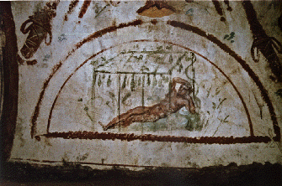
Commentary on Jonah
Jonah prefigurement of Christ and resurrection
Translations both from Hebrew and LXX
Emphasis on historical – but with Jonah as type of Christ

Slide 20
Gourd, Cucumber, or Ivy?
^{KJV} Jonah 4:6 And the LORD God prepared a gourd, and made it to come up over Jonah, that it might be a shadow over his head, to deliver him from his grief. So Jonah was exceeding glad of the gourd.
^{NRS} Jonah 4:6 The LORD God appointed a bush, and made it come up over Jonah, to give shade over his head, to save him from his discomfort; so Jonah was very happy about the bush.
^{VUL} Jonah 4:6 et praeparavit Dominus Deus hederam et ascendit super caput Ionae ut esset umbra super caput eius et protegeret eum laboraverat enim et laetatus est Iona super hedera laetitia magna
^{LXT} Jonah 4:6 καὶ προσέταξεν κύριος ὁ θεὸς κολοκύνθῃ καὶ ἀνέβη ὑπὲρ κεφαλῆς τοῦ Ιωνα τοῦ εἶναι σκιὰν ὑπεράνω τῆς κεφαλῆς αὐτοῦ τοῦ σκιάζειν αὐτῷ ἀπὸ τῶν κακῶν αὐτοῦ καὶ ἐχάρη Ιωνας ἐπὶ τῇ κολοκύνθῃ χαρὰν μεγάλην
^{CGT} Jonah 4:6
^{WTT} Jonah 4:6 וַיְמַ֣ן יְהוָֽה־אֱ֠לֹהִים קִיקָי֞וֹן וַיַּ֣עַל׀ מֵעַ֣ל לְיוֹנָ֗ה לִֽהְי֥וֹת צֵל֙ עַל־רֹאשׁ֔וֹ לְהַצִּ֥יל ל֖וֹ מֵרָֽעָת֑וֹ וַיִּשְׂמַ֥ח יוֹנָ֛ה עַל־הַקִּֽיקָי֖וֹן שִׂמְחָ֥ה גְדוֹלָֽה׃
Κολόκυνθα = gourd
Kikaion - cucumber

Slide 21
Commentary on Jeremiah
Unfinished (415)
More emphasis on Hebrew text – criticizes LXX, which he claims errant copyists have corrupted
More literal and less allegorical exegesis
Criticism of Origen (in midst of Pelagian controversy)

Slide 22
Commentary on Ephesians
‘Awake, O sleeper, and arise from the dead, and Christ shall give you light” (5:14)
Spoken to Adam – buried at Calvary
Calvary = place of skull = head of an ancient man buried there
Cross of Christ directly over the spot
Cf. art work of crucifixion
Not original – cf. Apollinarius of Laodicea

Slide 23
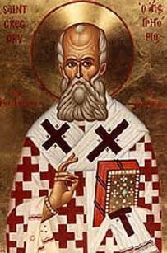
Gregory Nazianzus
329-390
Archbishop of Constantinople
Great Trinitarian theologian – especially in area of the Spirit
Great orator and rhetorician
Theosis
Involved in controversies throughout life (Arianism and Apollinarianism)
held form of universalism

Slide 24
Principles from Origen
Some things that do not occur in reality are mentioned in Holy Writ (anthropomorphisms)
Some things that occur are not mentioned
Some things that do not occur are not mentioned
Some things that occur are mentioned
Nazianzen’s exegesis always bound up in the theological situation

Slide 25
Oration 30 – Words in Context
IV. Well, what is the second of their great irresistible passages? “He must reign,”¹⁴ till such and such a time … and “be received by heaven until the time of restitution,”¹⁵ and “have the seat at the Right Hand until the overthrow of His enemies.”¹⁶ But after this? Must He cease to be King, or be removed from Heaven? Why, who shall make Him cease, or for what cause? What a bold and very anarchical interpreter you are; and yet you have heard that Of His Kingdom there shall be no end.¹⁷ Your mistake arises from not understanding that Until is not always exclusive of that which comes after, but asserts up to that time, without denying what comes after it. To take a single instance—how else would you understand, “Lo, I am with you always, even unto the end of the world?”¹ Does it mean that He will no longer be so afterwards. And for what reason? But this is not the only cause of your error; you also fail to distinguish between the things that are signified. He is said to reign in one sense as the Almighty King, both of the willing and the unwilling; but in another as producing in us submission, and placing us under His Kingship as willingly acknowledging His Sovereignty. Of His Kingdom, considered in the former sense, there shall be no end. But in the second sense, what end will there be? His taking us as His servants, on our entrance into a state of salvation. For what need is there to Work Submission in us when we have already submitted? After which He arises to judge the earth, and to separate the saved from the lost. After that He is to stand as God in the midst of gods,² that is, of the saved, distinguishing and deciding of what honour and of what mansion each is worthy.

Slide 26
Learning Obedience
VI. The same consideration applies to another passage, “He learnt obedience by the things which He suffered,”⁹ and to His “strong crying and tears,” and His “Entreaties,” and His “being heard,” and His “Reverence,” all of which He wonderfully wrought out, like a drama whose plot was devised on our behalf. For in His character of the Word He was neither obedient nor disobedient. For such expressions belong to servants, and inferiors, and the one applies to the better sort of them, while the other belongs to those who deserve punishment. But, in the character of the Form of a Servant, He condescends to His fellow servants, nay, to His servants, and takes upon Him a strange form, bearing all me and mine in Himself, that in Himself He may exhaust the bad, as fire does wax, or as the sun does the mists of earth; and that I may partake of His nature by the blending. Thus He honours obedience by His action, and proves it experimentally by His Passion. For to possess the disposition is not enough, just as it would not be enough for us, unless we also proved it by our acts; for action is the proof of disposition.

Slide 27
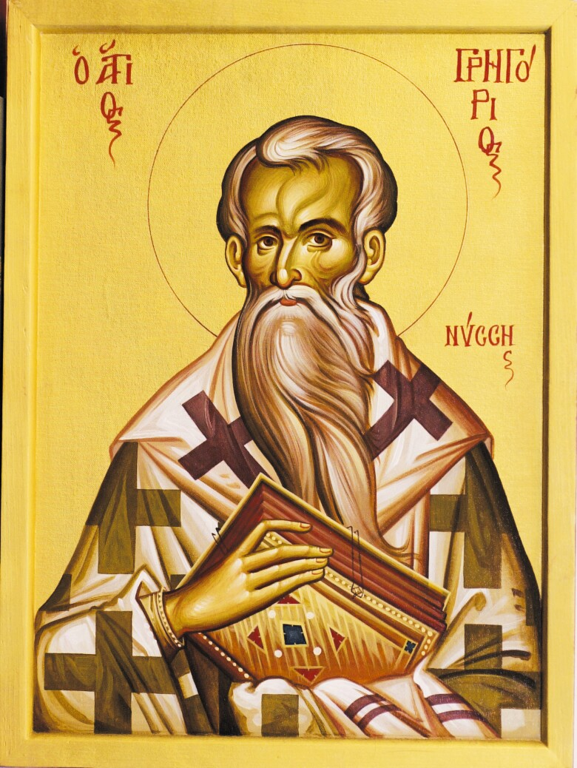
Gregory of Nyssa
335-395; bishop of Nyssa 372-395
Regarded as saint by RC, Eastern Orthodox, Lutherans, and Anglicans
Involved in some Christological controversies; primary mystical theologian
Most exegesis is philosophical in nature and centers on mystical ascent
Wrote against slavery
Influenced by Origen
Elder brother was Basil or Caesarea, friend was Gregory of Nazianzus – collectively called the Cappadocian Fathers

Slide 28
An Original Theologian
Argued for infinity of God
Life of Moses: any conception of God is not God and is therefore an idol
Apophatic theology
Three stages of ascent: darkness and ignorance; spiritual illumination; mystical contemplation of God but in darkness
Believed in universal salvation (ἀποκατάστασις) – 1 Cor 15 – God will be ‘all in all’
Some will require long purification

Slide 29
God Beyond All Praising
God unknowable; beyond any human conceptions
Can’t look on face of God and live = God is life; anything that we could behold would by definition not be God, therefore incapable of giving life
Life of Moses – all about mystical ascent
God approached and experienced in darkness
Note later mystics – cloud of unknowing; dark night of soul; etc

